Slide 1


TRIAD BUSINESS OVERVIEW
March 2016
Pioneers in Digital Retail Media
Confidential and proprietary. Copyright © 2016 Xaxis Incorporation. All rights reserved. Distribution without permission is prohibited.

Slide 2
TRIAD RETAIL MEDIA – AT A GLANCE
THE PROGRAMMATIC AUDIENCE COMPANY
OUR PRODUCT SUITE
“One Voice” Media Sales
Direct Ad Sales
Digital Marketing Services for Leading Retailers and Brands
Founded in 2004, Triad continues to pioneer how retailers,
brands & shoppers connect in the digital age.
We understand that the CPM doesn’t come first, customer experience and site conversion do. We have a proven track record with the world’s largest retailers and advertisers who want to more effectively reach shoppers.
Programmatic
16
Retail ecommerce partners
1,500+
Advertised brands
in 2015
Audience Extension
Ad Operations Data Mgmt Analytics
Creative & Content Marketing
CRM
Digital Media Buying
648
Professional in-house experts
~$660mm
2016 forecasted
media sales

Slide 3



CORNERSTONE IDEA
THE PROGRAMMATIC AUDIENCE COMPANY
SHOPPERS
2004
RETAILERS
BRANDS
Triad launches the first “digital retail media” campaign with Walmart
Private & Confidential

Slide 4
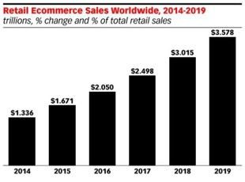
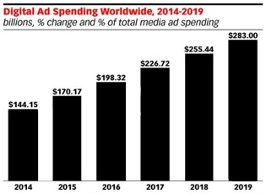
TWO MAJOR GROWTH TRENDS DRIVE OUR STRATEGY
THE PROGRAMMATIC AUDIENCE COMPANY
eCommerce Sales
Digital Ad Spending
OPPORTUNITY
Private & Confidential

Slide 5


WE CREATE VALUE AT THE INTERSECTION OF THESE TRENDS
THE PROGRAMMATIC AUDIENCE COMPANY
Digital Retail Media
eCommerce
Digital Advertising

Slide 6

WHAT WE DO

Slide 7













































RETAILERS PARTNER WITH TRIAD TO BECOME MEDIA PROPERTIES BY LEVERAGING THEIR AUDIENCE, DIGITAL ASSETS & PROPRIETARY SHOPPING DATA
THE PROGRAMMATIC AUDIENCE COMPANY
U.S. Partners Int’l Partners
MASS MERCHANT CLUB MARKETPLACE
UK
146MM
Monthly Unique Shoppers
DRUG
INTEGRATED RETAILER
DISCOUNT
AUSTRALIA
1.1B
Monthly Shopping Visits
DEPT. STORE
OFFICE SUPPLY
OFFICE SUPPLY
GERMANY
TOY & BABY
NETHERLANDS
16 Partners
Doing Business in 6 Countries

Slide 8
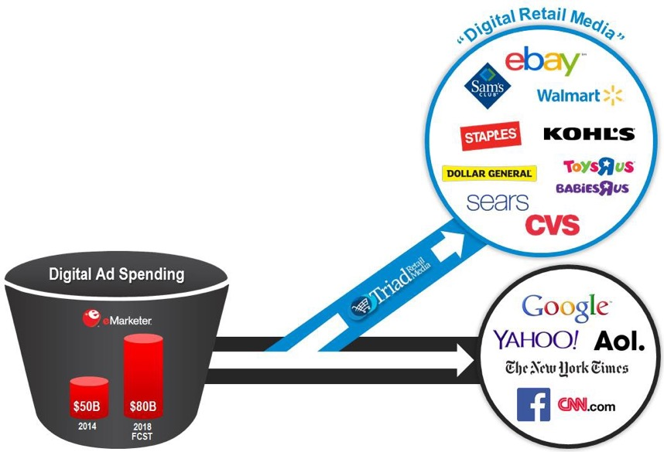

CREATING AN IMPORTANT NEW CATEGORY FOR NATIONAL MEDIA BUYERS
THE PROGRAMMATIC AUDIENCE COMPANY
Advertiser Benefits
Reaches consumers in the shopping mindset
Ads targeted with real shopping data
Measurable Performance

Slide 9

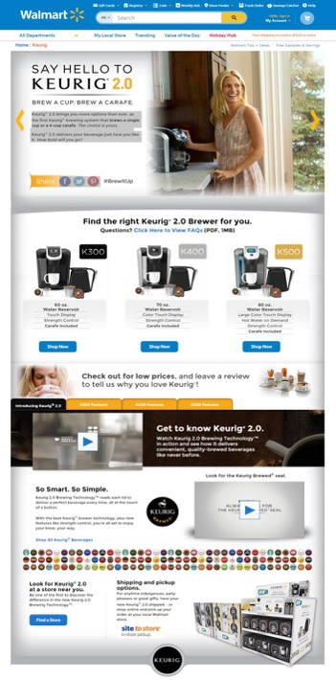







AN EXAMPLE OF HOW WE’RE UNIQUELY CONNECTING RETAILERS, BRANDS & SHOPPERS
THE PROGRAMMATIC AUDIENCE COMPANY

Slide 10












HOW WE MAKE MONEY
THE PROGRAMMATIC AUDIENCE COMPANY
+
+
=
RETAIL PARTNERS
ADVERTISERS
REVENUE
Media Program Creation
Technology Integration
Content / Editorial
Production &
Creative
Hosting , Analytics & Reporting
Financial, Billing & Collecting
We operate on a media revenue share basis
- On average we
keep approx. 25% of gross advertiser media billings
We retain 100% of all agency services that we provide
Establish exclusive partnerships
Stakeholder collaboration and willingness to work together
Approval to create products that attract brand promotional and national media agency dollars
Align on advertising targets, pricing and rules of engagement

Slide 11



WHAT MAKES US DIFFERENT
THE PROGRAMMATIC AUDIENCE COMPANY
100% Focused on Retail
Each of our partners is represented as stand- alone media properties (we do not sell like an ad network)
“One Voice” in the market (optimizing direct ad sales, programmatic & off-site audience extension)
Complete outsourced solution with aligned incentives
A strong culture of customer service and
delivering results
AD SALES & ACCT MGMT
AGENCY SERVICES
DATA & TECHNOLOGY

Slide 12

AD SALES & ACCOUNT MANAGEMENT

Slide 13











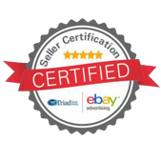



BRANDS PARTNER WITH TRIAD TO REACH CONSUMERS WHEN THEY’RE IN THE ACTIVE SHOPPING MINDSET
THE PROGRAMMATIC AUDIENCE COMPANY
We Have Well-Established Relationships with Advertisers
We Also Have Deep Relationships with all of their National Media Agencies
. . . and we’ve created industry-leading “Sales Certification Programs” to stay out in front of all major digital media selling trends

Slide 14
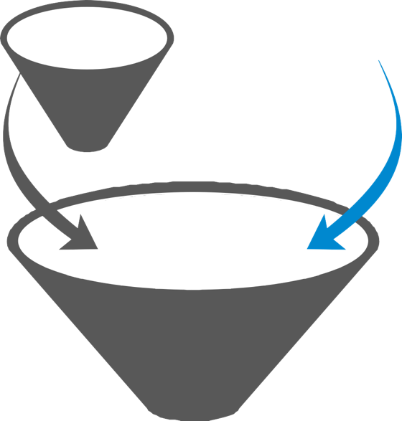






UNLOCKING VALUE BY WORKING WITH ALL NATIONAL FUNDING SOURCES
THE PROGRAMMATIC AUDIENCE COMPANY
+
Where Triad is Attracting
Incremental Revenue:
RETAILER
Trade & Co-op
National Media Dollars
Media
Agencies
HQ
Brand Direct
RETAILER
Maximized Profits
Increased Margins
Increased Traffic
New Brand Content
Enhanced Customer Experience
Trading Desks
Shopper Marketing

Slide 15










THE AD REVENUE WE ATTRACT IS CRITICAL FOR OUR RETAILERS
THE PROGRAMMATIC AUDIENCE COMPANY
ATTRACT AD REVENUE
DELIVER STRONG ROI FOR ADVERTISER
IMPROVED CUSTOMER EXPERIENCE
MORE TRAFFIC & INCREASED SALES

Slide 16
WHY RETAILERS DON’T JUST DO IT THEMSELVES
THE PROGRAMMATIC AUDIENCE COMPANY
RETAILERS ARE NOT PUBLISHERS: Our outsourced model allows retailers to focus on their core business, while Triad’s focus is on attracting incremental national media revenue & great customer content.
UNMATCHED “FEET-ON-THE-STREET”: 35% of our 600+ employees are dedicated to front-line sales & sales support with extensive advertiser and agency relationships
COMPREHENSIVE FULL-SERVICE AGENCY CAPABILITIES
AGILITY: Retailers have their hands full handling their growing ecommerce
businesses and have difficulty ramping up quickly to meet new opportunities
TECHNOLOGY: Proprietary workflow platform that enables our sellers to sell more; we manage over 3,000 campaigns per year.
VALUES & CULTURE: Agency culture driven by a passion for customer service & results is key to winning in media business.

Slide 17

AGENCY SERVICES

Slide 18
TRIAD IS UNIQUELY POSITIONED TO PROVIDE BRANDS WITH FULL MARKETING SOLUTIONS POWERED BY A RELEVANT & DIVERSIFIED PRODUCT PORTFOLIO
THE PROGRAMMATIC AUDIENCE COMPANY
Display Programmatic eCommerce Action Ads
Takeovers & Rich Media IAB & Custom
Audience Extension
Desktop Display
Mobile Display Video
Social Remarketing
Creative & Content
Brand Pages
Brand Showcases Seasonals & Centers Custom Content Dev Editorial Planning SME Sourcing
Native
Product Listing Ads
Email Postcards Banners CRM
In-Store
Mobile
Mweb & In-App App Development
In-Store Beacon Enabled Ads
Social Share & Save Twitter Parties
Blogging
Facebook, YouTube, Twitter Sweepstake
SEM
Video
Development & Production
PRODUCT
PORTFOLIO

Slide 19

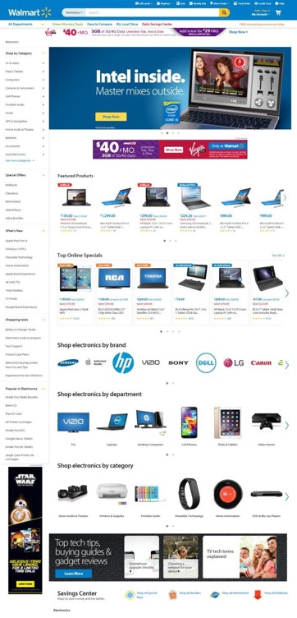

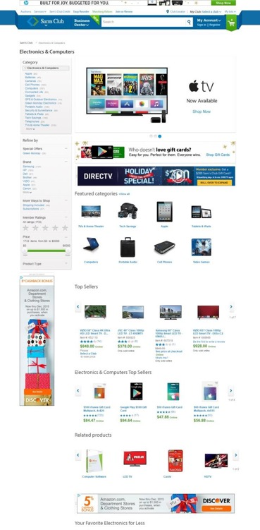














1. ON-SITE DISPLAY
2. MOBILE DISPLAY
3. CONTENT DEVELOPMENT
4. CONTENT SPONSORSHIPS
5. EMAIL
6. OFFSITE AUDIENCE EXTENSION
7. OFFSITE SEM
8. PLA’s (ON & OFFSITE)
9. SOCIAL ENGAGEMENT
10. IN-STORE TV
11. VIDEO

Slide 20

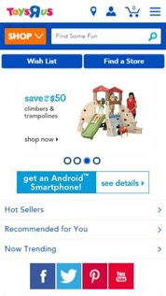
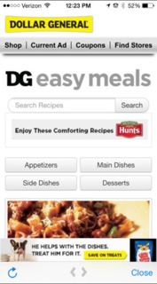


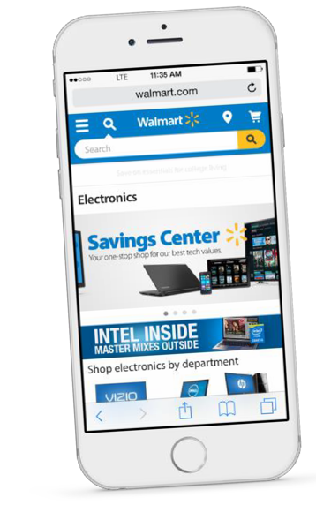

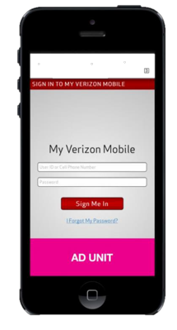


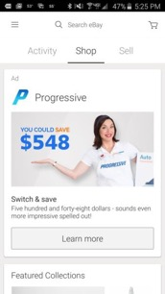
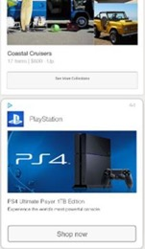



1. ON-SITE DISPLAY
2. MOBILE DISPLAY
3. CONTENT DEVELOPMENT
4. CONTENT SPONSORSHIPS
5. EMAIL
6. OFFSITE AUDIENCE EXTENSION
7. OFFSITE SEM
8. PLA’s (ON & OFFSITE)
9. SOCIAL ENGAGEMENT
Native
Mobile
10. IN-STORE TV
11. VIDEO

Slide 21


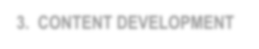

1. ON-SITE DISPLAY
2. MOBILE DISPLAY
Scrollable Product Features
3. CONTENT DEVELOPMENT
Social Sharing
4. CONTENT SPONSORSHIPS
5. EMAIL
6. OFFSITE AUDIENCE EXTENSION
Dynamic Product Feed & “Buy Now”
7. OFFSITE SEM
8. PLA’s (ON & OFFSITE)
Video Product Demos
9. SOCIAL ENGAGEMENT
10. IN-STORE TV
Associated Products
11. VIDEO

Slide 22


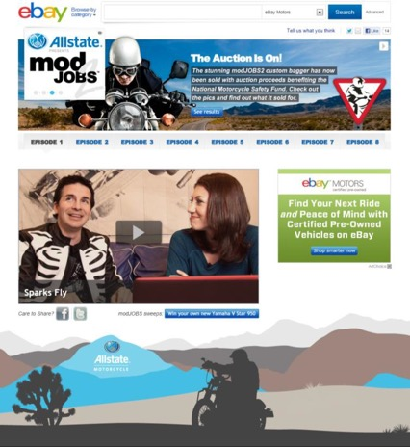
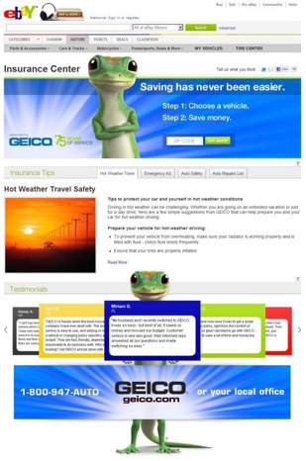

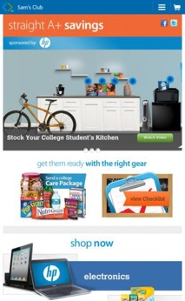


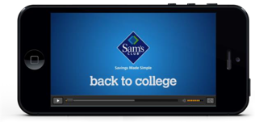
1. ON-SITE DISPLAY
2. MOBILE DISPLAY
3. CONTENT DEVELOPMENT
5. EMAIL
4. CONTENT SPONSORSHIPS
6. OFFSITE AUDIENCE EXTENSION
7. OFFSITE SEM
8. PLA’s (ON & OFFSITE)
9. SOCIAL ENGAGEMENT
10. IN-STORE TV
11. VIDEO

Slide 23






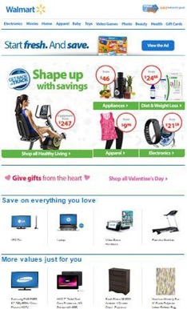




1. ON-SITE DISPLAY
2. MOBILE DISPLAY
Special Brand Take-Over Email
Targeted & Personalized
3. CONTENT DEVELOPMENT
Standard Email Integration
4. CONTENT SPONSORSHIPS
5. EMAIL
6. OFFSITE AUDIENCE EXTENSION
7. OFFSITE SEM
8. PLA’s (ON & OFFSITE)
9. SOCIAL ENGAGEMENT
10. IN-STORE TV
11. VIDEO

Slide 24


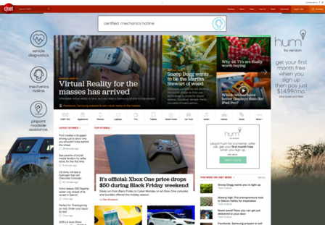

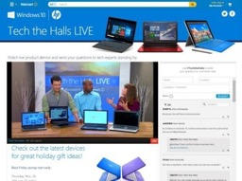
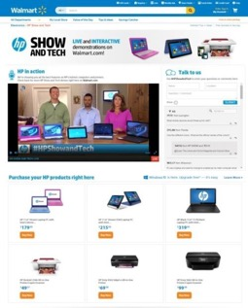


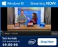
1. ON-SITE DISPLAY
2. MOBILE DISPLAY
3. CONTENT DEVELOPMENT
4. CONTENT SPONSORSHIPS
5. EMAIL
6. OFFSITE AUDIENCE EXTENSION
7. OFFSITE SEM
8. PLA’s (ON & OFFSITE)
9. SOCIAL ENGAGEMENT
10. IN-STORE TV
11. VIDEO

Slide 25





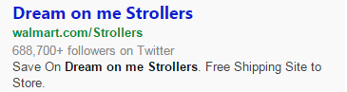
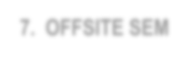
1. ON-SITE DISPLAY
PAID SEARCH AS ADVERTISING PRODUCT
2. MOBILE DISPLAY
3. CONTENT DEVELOPMENT
4. CONTENT SPONSORSHIPS
Mobile
Tablet
Desktop
5. EMAIL
6. OFFSITE AUDIENCE EXTENSION
7. OFFSITE SEM
8. PLA’s (ON & OFFSITE)
Sample Keyword Strategy:
Non-Branded Key Words
“Stroller” “Crib”
Advertiser Branded Key Words
“Dream on Me” “Mia Moda”
Walmart Co-Branded Key Words
“Dream on Me at Walmart”
9. SOCIAL ENGAGEMENT
10. IN-STORE TV
11. VIDEO

Slide 26
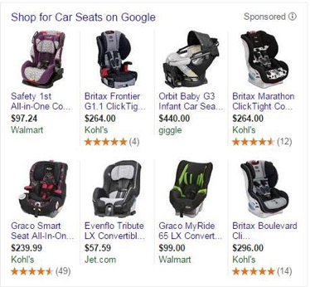

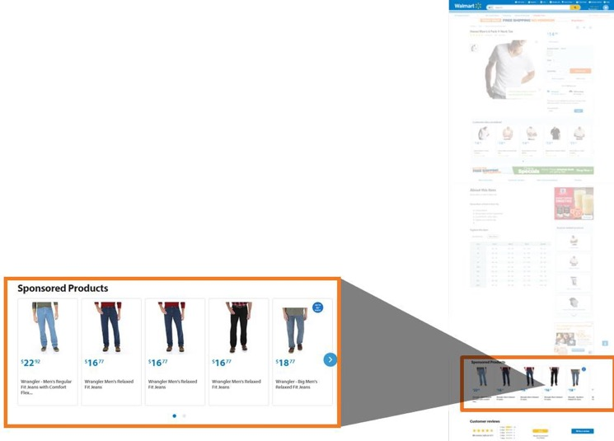


OFFSITE PLA’S
1. ON-SITE DISPLAY
2. MOBILE DISPLAY
ON-SITE PLA’S
3. CONTENT DEVELOPMENT
4. CONTENT SPONSORSHIPS
5. EMAIL
6. OFFSITE AUDIENCE EXTENSION
7. OFFSITE SEM
8. PLA’s (ON & OFFSITE)
9. SOCIAL ENGAGEMENT
10. IN-STORE TV
11. VIDEO

Slide 27
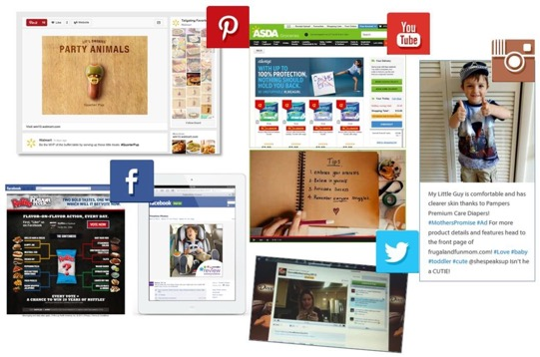
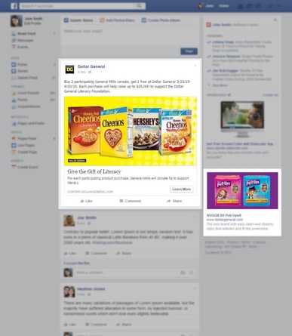





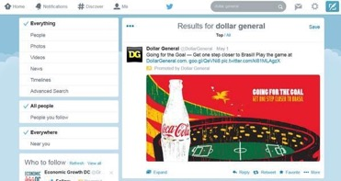
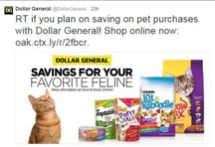

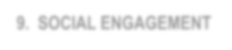
1. ON-SITE DISPLAY
2. MOBILE DISPLAY
3. CONTENT DEVELOPMENT
4. CONTENT SPONSORSHIPS
5. EMAIL
6. OFFSITE AUDIENCE EXTENSION
7. OFFSITE SEM
8. PLA’s (ON & OFFSITE)
9. SOCIAL ENGAGEMENT
10. IN-STORE TV
11. VIDEO

Slide 28




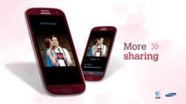
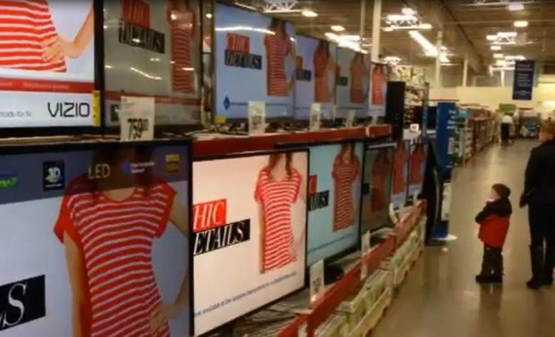

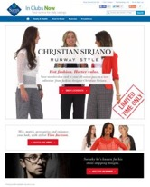

IN-CLUB TV
1. ON-SITE DISPLAY
2. MOBILE DISPLAY
3. CONTENT DEVELOPMENT
4. CONTENT SPONSORSHIPS
5. EMAIL
Triad = Creative & Sales AOR
x600 Clubs Across the Country
6. OFFSITE AUDIENCE EXTENSION
7. OFFSITE SEM
d
8. PLA’s (ON & OFFSITE)
Connecting In-Store& Digital
9. SOCIAL ENGAGEMENT
10. IN-STORE TV
11. VIDEO

Slide 29


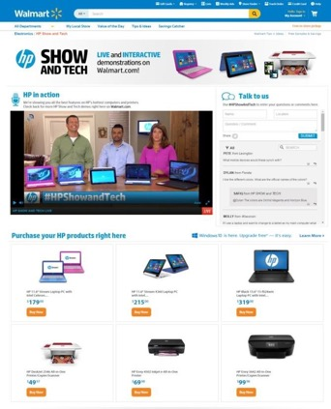
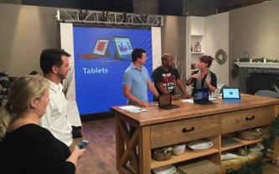
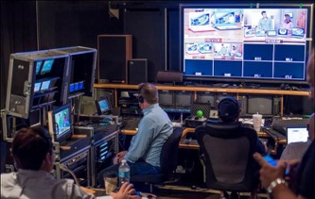

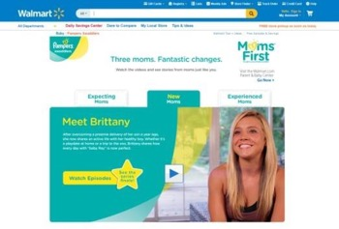


Custom Content: Live Streaming Video Event
1. ON-SITE DISPLAY
2. MOBILE DISPLAY
3. CONTENT DEVELOPMENT
4. CONTENT SPONSORSHIPS
5. EMAIL
6. OFFSITE AUDIENCE EXTENSION
7. OFFSITE SEM
8. PLA’s (ON & OFFSITE)
SOCIAL ENGAGEMENT
Video Selector Tool
IN-STORE TV
Private &
11. VIDEO

Slide 30

DATA SOLUTIONS

Slide 31




TRIAD’S PROXIMITY TO 1ST PARTY DATA ALLOWS FOR CORROBORATION & VALIDATION WHERE OTHERS ARE GUESSING
THE PROGRAMMATIC AUDIENCE COMPANY
“2nd Party” Advertiser Data
3rd Party Data
1st Party Retailer Data
Institutional Knowledge
(People & Experience)
Our
Retail ₁St
Party
Data
Guessing Continuum
Knowing

Slide 32


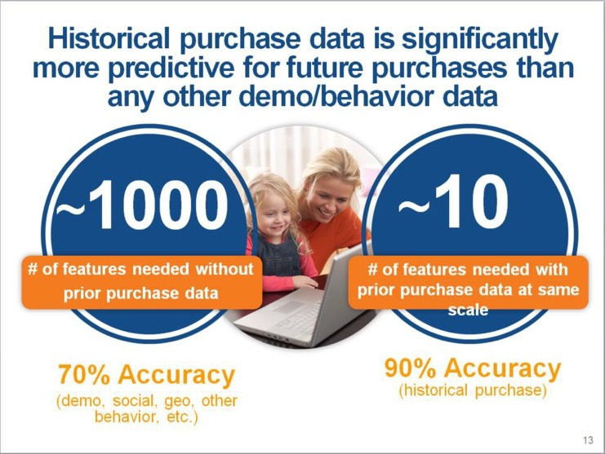

Brian Monahan, VP of Mktg, Walmart.com iMedia Summit Presentation (Sep 2015)

Slide 33






TRIAD’S UNIQUE ROLE IN ADVANCING NEW DATA SOLUTIONS @ RETAIL
THE PROGRAMMATIC AUDIENCE COMPANY
Data Product Mgmt & Leadership
Audience Segment Building
Patent Pending Proprietary Audience Tool
Retailer Training
Training WM Users Project Mgmt for Advertising Team
Successfully connected WMX to our UK-based ad server (DFP) for ASDA
Won analytics responsibility from Accenture
Early Stages for building Online to Offline
Expecting to receive Customer Care data Q2 2016
Centralizing data to optimize media selling & buying

Slide 34



THE EVOLUTION OF DATA OPTIMIZATION @ TRIAD
THE PROGRAMMATIC AUDIENCE COMPANY
Future Vision
Real time, machine learning algorithms leveraging campaign readings and first party data to optimize store & online conversion across all devices.
Dashboards for top partners showcasing audience insights and recommendations.
Rest of market impact.
Media mix optimization across all channels of buying (Direct IO on desktop and mobile, PMP, RTB and Audience Extension).
Current State
Retailer 1st party data +
3rd party data
Advanced audience segment building
In-flight optimization
Advanced Analytics moving into predictive Analytics
Back-end performance based metrics (Conversions, Sales Lift, ROAS)
In the Beginning
Contextual Targeting
Publisher traffic stats
Basic media delivery
Front end media buying metrics (CPM, CPC, Clicks)

Slide 35

HOW WE MANAGE DATA TO OFFER - UNIQUE SOLUTIONS TO BRANDS & RETAILERS
THE PROGRAMMATIC AUDIENCE COMPANY
OUR FOCUS
Data Type
Data Sources
Technology Provider
Audience Tools Today
Applications Roadmap
On-Site browsing
Site-log
files
Site-hosting
agent
Targeting &
Sales Insights
Custom creative
On-Site search
Audience Optimization
Creative
Optimization
Ad
exposure
Server-log files
Ad –server & DSP
In-store
buying
Retail data warehouse
Offline onboarder
Open-web discovery models
Predictive
modeling
Advertiser
“2nd party”
Advertiser
RTB
impression value optimization
Impact
measurement
Compiled 3rd party
Data Exchange

Slide 36



In Addition, our Data Science Team is Building Patent Pending Audience Tools that are Maximizing the Value of Every Impression
“INNOVATE”
Creating custom audiences based on specific advertiser strategies and needs
“PERFORM”
Optimizing through precision and predictive data- driven models
“BOOST”
Expanding reach of high performing segments via audience look-a- like models
Dan Kelman
VP, Data Science

Slide 37


DATA SOLUTIONS

Slide 38



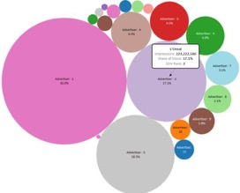
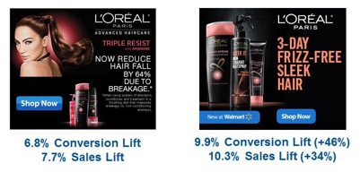

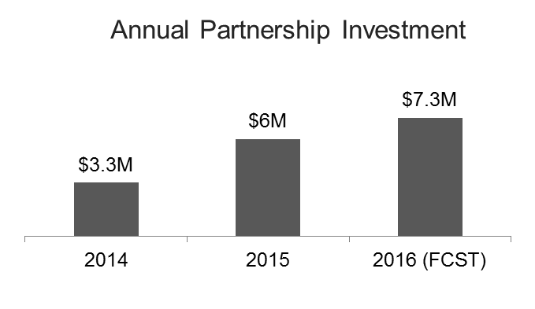

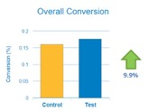
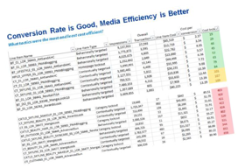
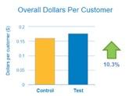
DATA USE CASE:
THE PROGRAMMATIC AUDIENCE COMPANY
1. Pre-Sale SOV Analysis
In-Flight Creative Optimization
B.
Share-of-Voice Report
4. Annual Investment Validation
3. Post-Campaign Sales Lift Reporting

Slide 39

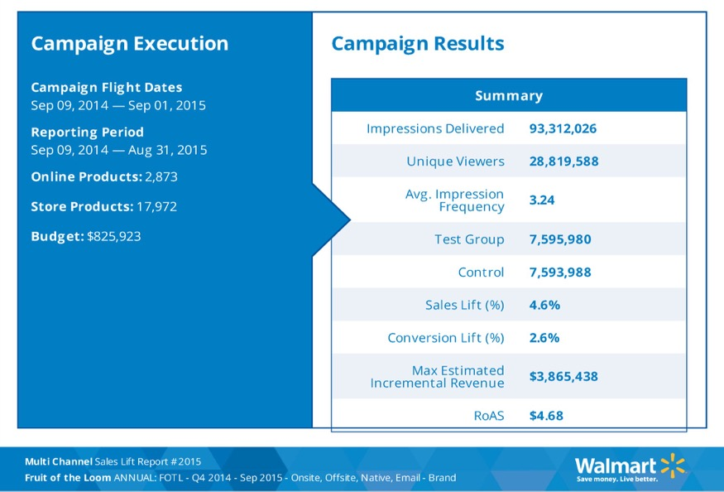



SAMPLE SALES LIFT REPORT:
THE PROGRAMMATIC AUDIENCE COMPANY

Slide 40

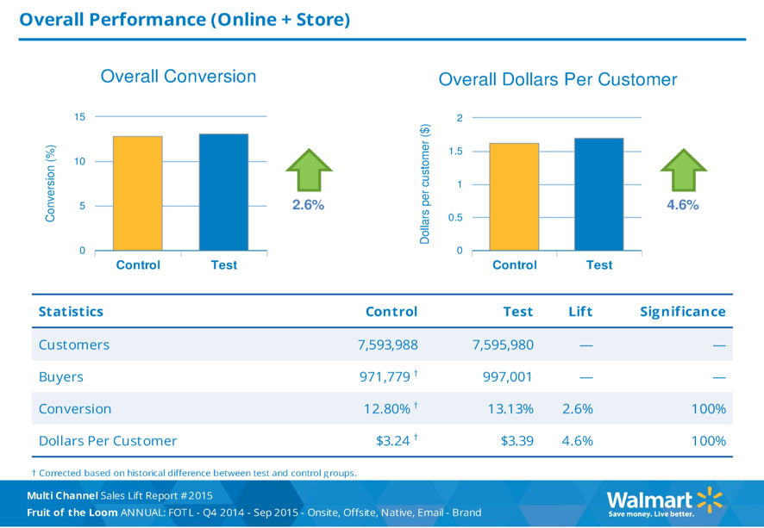
SAMPLE SALES LIFT REPORT:
THE PROGRAMMATIC AUDIENCE COMPANY

Slide 41



TRIAD RETAIL MEDIA = THE WMX EXPERTS
THE PROGRAMMATIC AUDIENCE COMPANY
2000+
Reports Created
1000+
Reports Delivered
2000+
Client Calls
“The Partnership Analytics team at Triad have been amazing partners and have helped to define, and refine many significant parts of the WMX product offering.
Their partnership, feedback, and insight have helped build strong relationships with our advertising partners. They have helped advertisers develop a deep understanding of WMX and all it can offer to help them maximize their advertising dollars.”
Zach Poley, Sr. Director of Engineering, @WalmartLabs

Slide 42


DATA SOLUTIONS

Slide 43












TRIAD’S DATA PARTNERSHIP WITH EBAY
THE PROGRAMMATIC AUDIENCE COMPANY
Advertiser
1st Party user level data:
Triad Data Sciences
Purchase
Attributes (Age, Gender, HHI, etc)
Search
Browse
Triad Business Intelligence
Triad Analytics
Cookie-based data:
Search
Browse
Triad Data Warehouse
Triad’s teams leverage eBay data to drive stronger performance, audience creation and marketing insights

Slide 44



EBAY DATA STRATEGY: EVERY CAMPAIGN STARTS AND ENDS WITH DATA
THE PROGRAMMATIC AUDIENCE COMPANY
Pre-Sale
In-Campaign
Post- Campaign
Brand Insights
Category Velocity Stats
Search Activity
Browse and Search related to brands
Audience Profiles
Campaign Responder Profile
Custom Audience/Targeting Creation
Boost High-Performing Segments
Quarterly Business Reviews
Custom Insights/Analytics Support
Engagement rate by device
Propensity to buy
Market share
Pre-Sale Insights begin every sales conversation
Mid-Campaign Insights drive incremental revenue from advertisers
Post Campaign Analytics is key to re-engaging top accounts

Slide 45

SAMPLE EBAY SALES PITCH
THE PROGRAMMATIC AUDIENCE COMPANY
Leverage 1st Party Data to Drive Advertiser Demand

Slide 46

SAMPLE EBAY SALES PITCH:
THE PROGRAMMATIC AUDIENCE COMPANY

Slide 47

SAMPLE EBAY SALES PITCH:
THE PROGRAMMATIC AUDIENCE COMPANY

Slide 48



SAMPLE EBAY SALES PITCH:
THE PROGRAMMATIC AUDIENCE COMPANY

Slide 49

SAMPLE EBAY SALES PITCH:
THE PROGRAMMATIC AUDIENCE COMPANY

Slide 50



CUSTOMER INSIGHTS AND DATA BRING CREATIVE TO LIFE
THE PROGRAMMATIC AUDIENCE COMPANY
CRM: Personalized email based on her onsite behavior dynamically delivers special offers
How we use data to enhance our
work:
Understanding the target audience helps us design and connect in a familiar way
Data-powered product modules deliver immediate and relevant offerings
Human interaction and focus groups confirm and provide additional depth of data trends and design

Slide 51

TECHNOLOGY SOLUTIONS

Slide 52





















BY DESIGN, TRIAD IS NOT AN “AD TECH” COMPANY WE SOURCE THE BEST TECH SOLUTIONS DEPENDING ON OUR RETAILER NEEDS
THE PROGRAMMATIC AUDIENCE COMPANY
Ad-Servers
DSPs
SSPs
DMPs
Viewability &
Brand Safety
Rich Media Ad-Servers

Slide 53









RETAILER ADVERTISING MANAGEMENT PLATFORM TRIAD’S PROPRIETARY, AUTOMATED, FLEXIBLE WORKFLOW SOLUTION
THE PROGRAMMATIC AUDIENCE COMPANY
Workflow Process
Project Management
Analytics & Insights
Advertiser Billing &
CRM
Yield & Delivery
Management
Financial
Management
Media Planning & Inventory Management
Campaign Management & Optimization
Partner Integrations
Pipeline Reporting
Contact Management
All Pitches
Customer Interactions
Digital Asset Management (DAM)
Creative Libraries
Project Schedules
/Resources
Sell Through Rates
CPM
Analytics and Program Performance
Campaign Results/Final Reports
Advertiser Billing
Financial Management
Invoicing
Platforms
Triad has developed our own advertising platform, customizing (including over 2 million lines of code) to provide workflow management and systems integration.

Slide 54








SAM’S CLUB BPM PROJECT - BUILDING BLOCKS OF SUCCESS
THE PROGRAMMATIC AUDIENCE COMPANY
Single Source of Truth
One consistent location for information across all teams and process events. Full transparency of work status, exceptions, and actions.
Process Rules Management
Allowing team members to initiate specific actionable work, facilitating process discipline to achieve maximum productivity.
Information at Your Fingertips
Optimizing the presentation of information by task, team, and individual role to maximize productivity.

Slide 55

TRIAD BPM PROJECT | FOCUS
THE PROGRAMMATIC AUDIENCE COMPANY
Addressed manual
inefficiencies

Slide 56

OUR PEOPLE & CULTURE

Slide 57

We Believe that Shopper Connections Don’t Happen
Without People Making the Connections

Slide 58































OUR CURRENT ORGANIZATION DESIGN
THE PROGRAMMATIC AUDIENCE COMPANY
OUR CURRENT ORGANIZATION DESIGN
OUR EMERGING PRODUCT ORGANIZATION
Business Owners
Product Owners
David Haase
eBay & US Retail
Sherry Smith
Walmart & SC
Jill Orr
International
Will Cohen
Mobile
Dan Kelman
Data
Mark Fishkin
Social
Brian Quinn Revenue & New Business
Tom Baumlin
Finance
John Kuemmel
Technology
Eric Meth
Programmatic
Peter Bavaro
Video
Marty Strasen
CRM
Joe Reichl Operational Excellence
Wendy Larrison
Talent
Misty Brown
Culture
Chris Shindelbower
Triad Labs

Slide 59

COMPLETE OUTSOURCED SOLUTION THAT IMMEDIATELY EXTENDS RETAILER’S TEAM
THE PROGRAMMATIC AUDIENCE COMPANY
“The rationale for outsourcing is thus changing dramatically; a growing number of organizations see it as a means of obtaining strategic advantages, not just a cost-cutting measure.” -- PWC Global, Shared Services and Outsourcing

Slide 60
OUR TEAM
THE PROGRAMMATIC AUDIENCE COMPANY
 | # of Professionals | % of Total
Front Line Sales & Support | 213 | 35%
Creative and Content | 115 | 19%
Client Management | 26 | 4%
Technology / Data and Analytics | 79 | 13%
Operations | 112 | 18%
Product Development | 10 | 2%
Finance and HR | 29 | 5%
All Other | 28 | 4%
612
100%

Slide 61















OUR UNIQUE BUSINESS REALITIES
THE PROGRAMMATIC AUDIENCE COMPANY
CORE VALUES
It’s Relationships That Matter Most
We become an extension of our retailer partners
What we do is new, and not easy
Digital Media and Retail move very fast
We’re Here To Solve Problems
We’re Always Looking Ahead

Slide 62





















WE ARE AN EXTENSION OF OUR RETAILER PARTNERS
THE PROGRAMMATIC AUDIENCE COMPANY

Slide 63



TRIAD RETAIL MEDIA:
THE PROGRAMMATIC AUDIENCE COMPANY
SHOPPERS
Digitally empowered; always on
Proud to partner with world’s largest retailers and brands to serve the shopper
RETAILERS
More digital touch- points then ever; rich 1st party data
BRANDS
Great content & insightful customer data

Slide 64
OUR GROWTH PLAN

Slide 65






TRIAD GROWTH PLANKS
THE PROGRAMMATIC AUDIENCE COMPANY
Grow The Core
+
Add More
Expand Existing Partners
New Retail Services
Add New Retailers
Video, Mobile, Social
International Expansion
New Products

Slide 66

OUR FINANCIAL PERFORMANCE

Slide 67


FINANCIAL OVERVIEW
THE PROGRAMMATIC AUDIENCE COMPANY
PRO FORMA
ADJUSTED EBITDA GROWTH
REVENUE GROWTH
($ in Millions)
($ in Millions)
Gross Revenue
Net Revenue
$664
$43
39% Gross
41% CAGR
$127
Revenue CAGR
$8
$153
$46
FY2011A FY2012A FY2013A FY2014A FY2015A FY2016E
FY2011A FY2012A FY2013A FY2014A FY2015A FY2016E
Net Margin: 36% 31% 31% 24% 24% 23%
Margin (Net): 17% 22% 29% 24% 29% 28%

Slide 68

ROGER BERDUSCO
CEO

